Slide 1


Titolo presentazione sottotitolo
Brain Lesion Segmentation
in MRI Images
Milano, XX mese 20XX
Group Number: 17
Mattia Pezzano
Luca Ricco
Maurizio Tirabassi

Slide 2
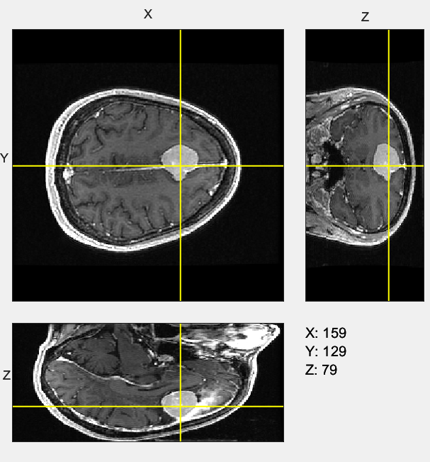
Introduction
Task: to segment a brain lesion from MRI data
The orthosliceViewer() MATLAB function was used to visualize the volume to identify the regions of interest (ROI)

Slide 3
Pipeline
slice = imcrop(slice, [], window);
filtered = medfilt2(slice);
cropped = im2double(filtered);
thresholded = cropped > 0.50 &
cropped < 0.85;
label = bwlabel(thresholded);
stats = regionprops(logical(thresholded), 'Solidity', 'Area’);
density = [stats.Solidity];
area = [stats.Area];
denseArea = density > 0.6;
maxArea = max(area(denseArea));
lesionLabel = find(area == maxArea);
lesion = ismember(label, lesionLabel);
filled = imfill(lesion, 'holes’);
segmented = overlay(slice, lesion, window);

Slide 4
Noise Sensitivity Analysis
Checking whether the introduction of a priori filters will benefit or not the performances of our pipeline
Median filtering was kept
Same experiment with averaging filter worsened the performance

Slide 5
Dice Coefficient Comparison
Manual segmentation for reference as ground truth
Effect of local operators: gamma correction
Difference with Otsu thresholding

Slide 6
Command-Line Interface (CLI)
>>Insert the plane of interest (enter to quit): axial
>>Insert noise to add (enter if none): salt & pepper
>>Insert noise level: 0.1

